Slide 1
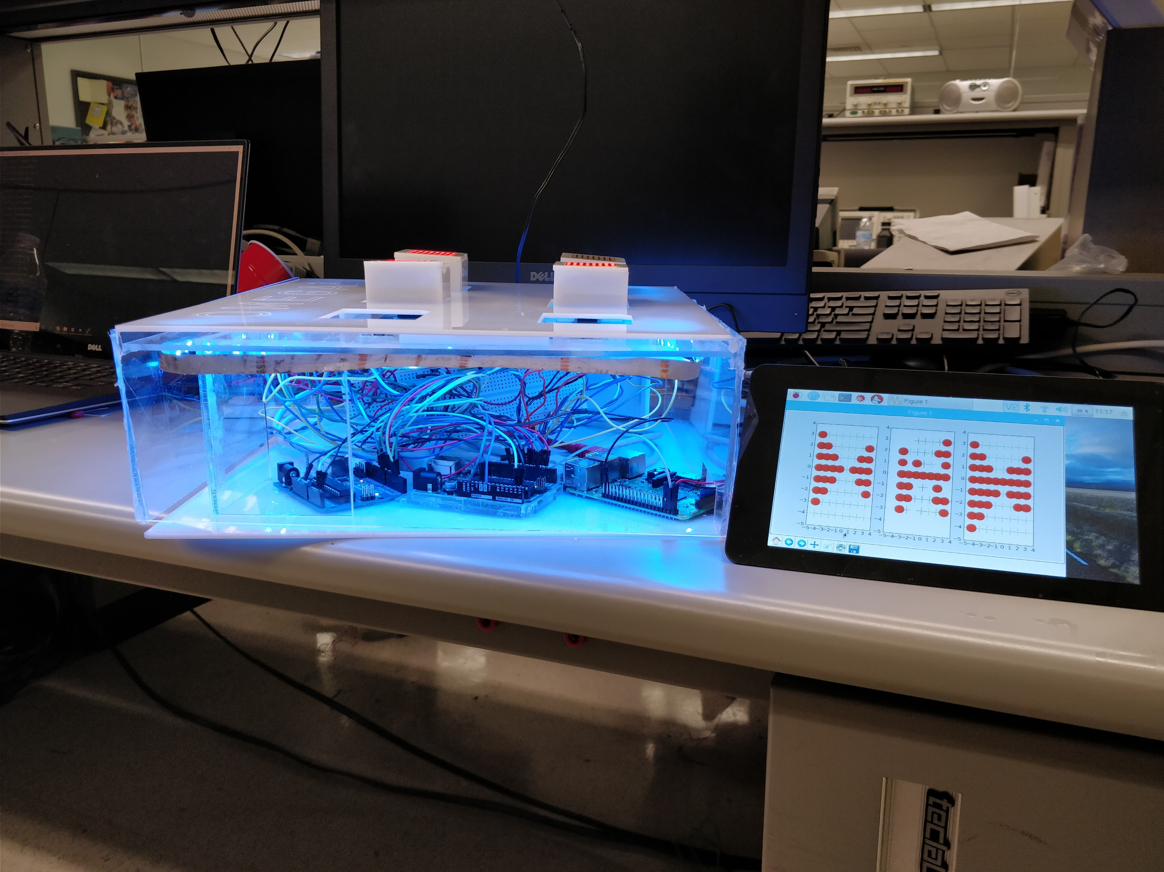
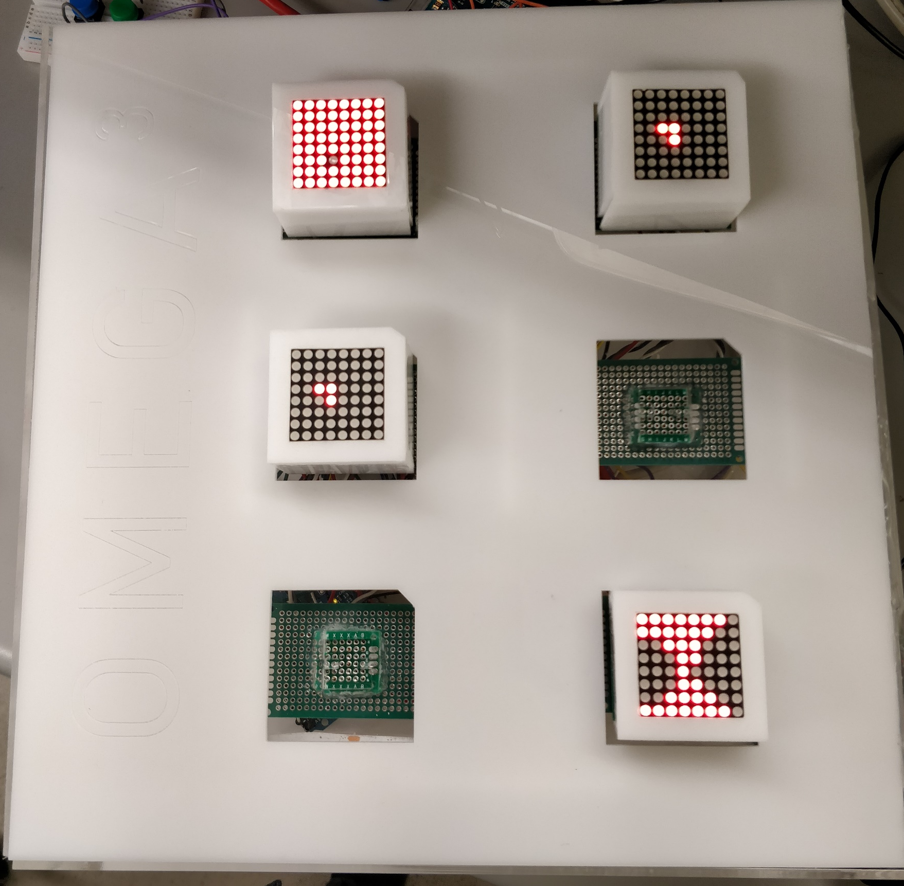
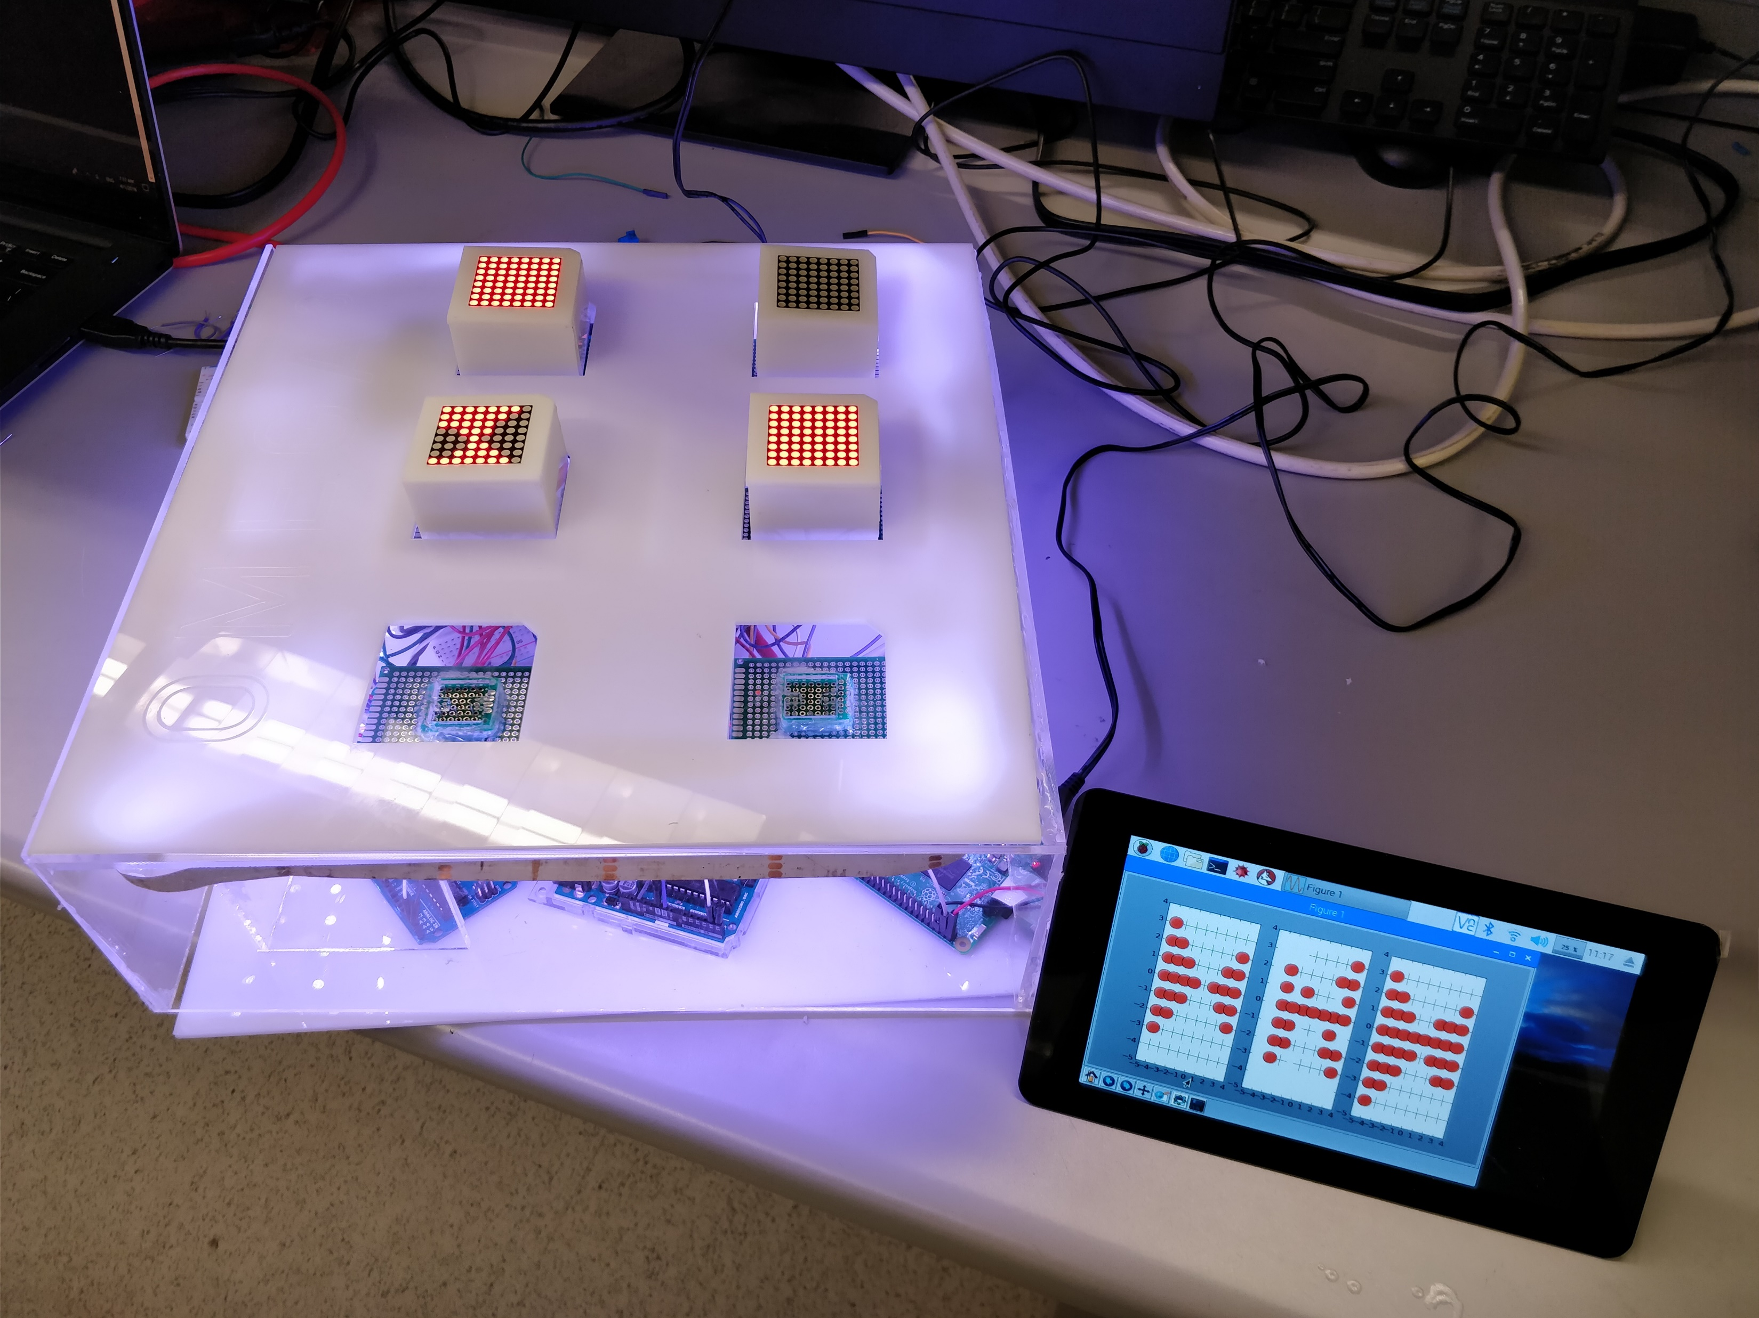
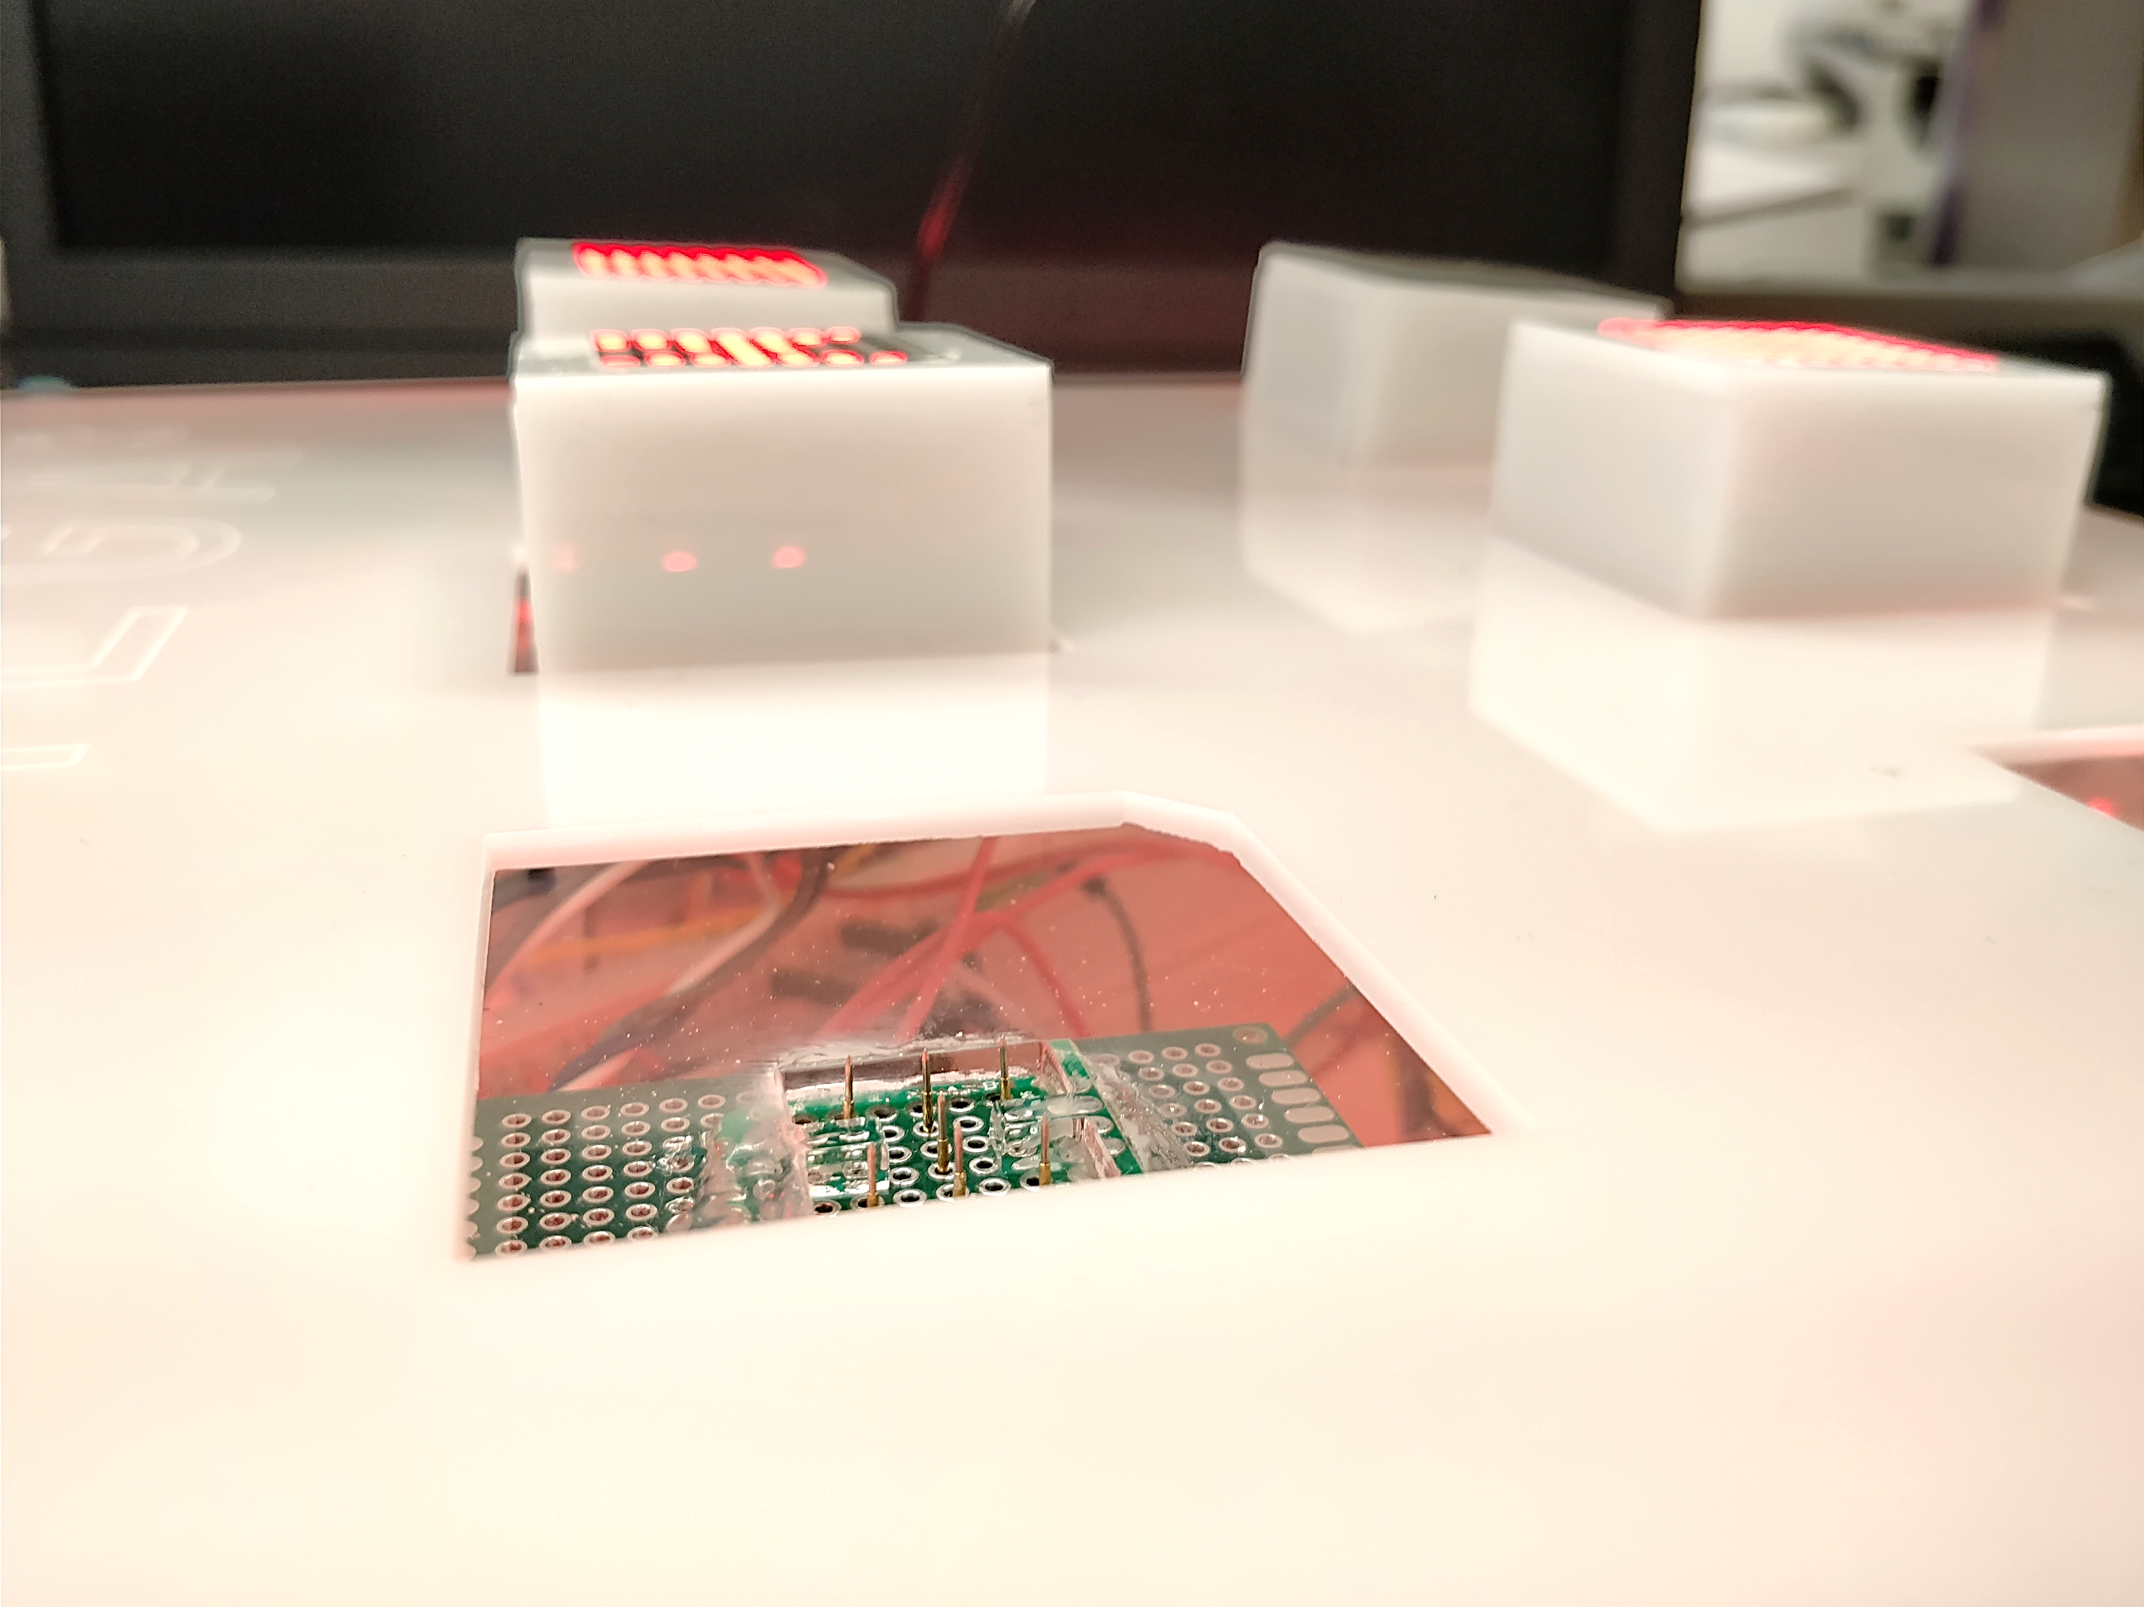

Slide 2
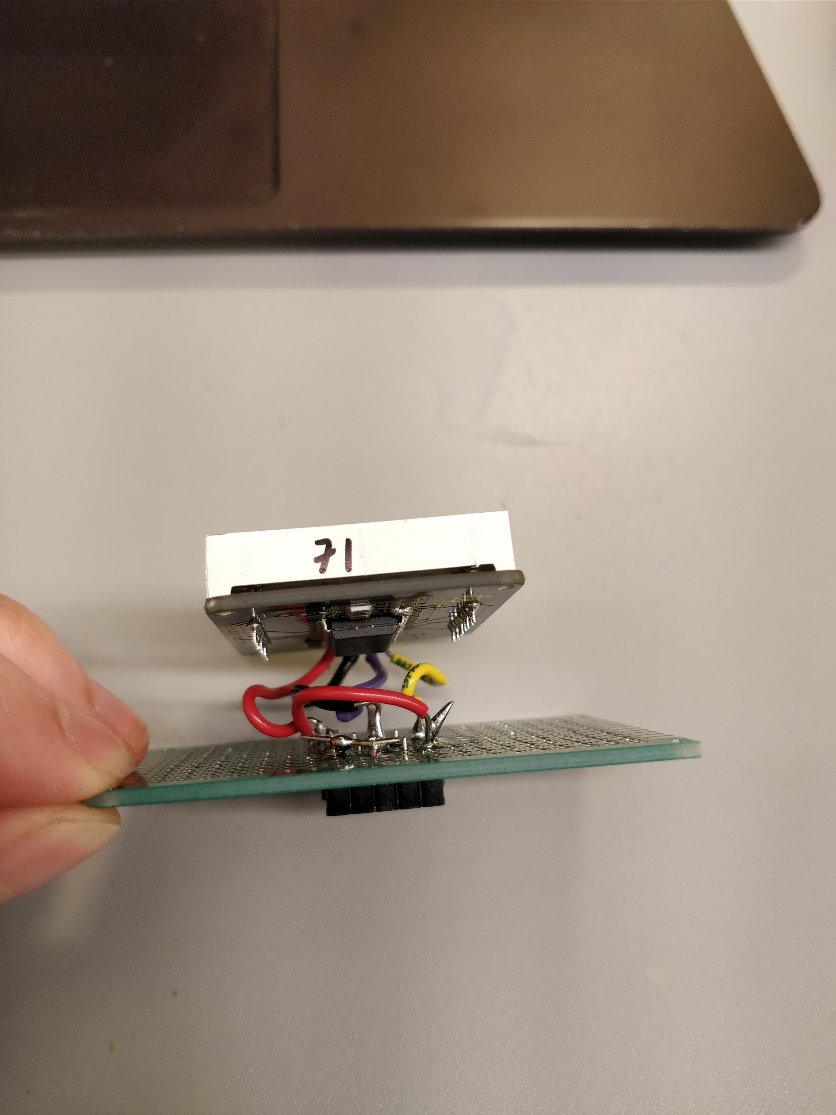
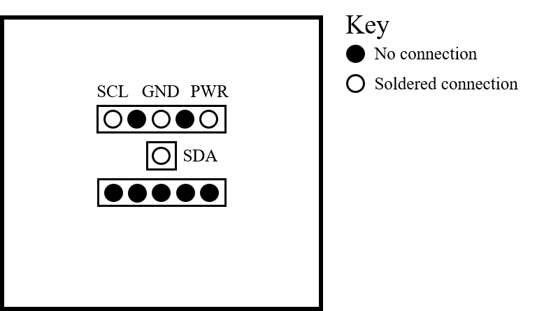
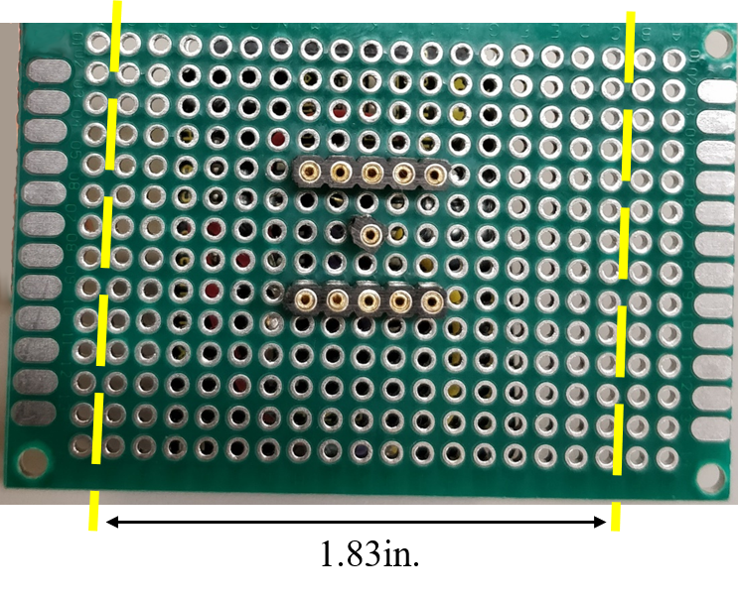
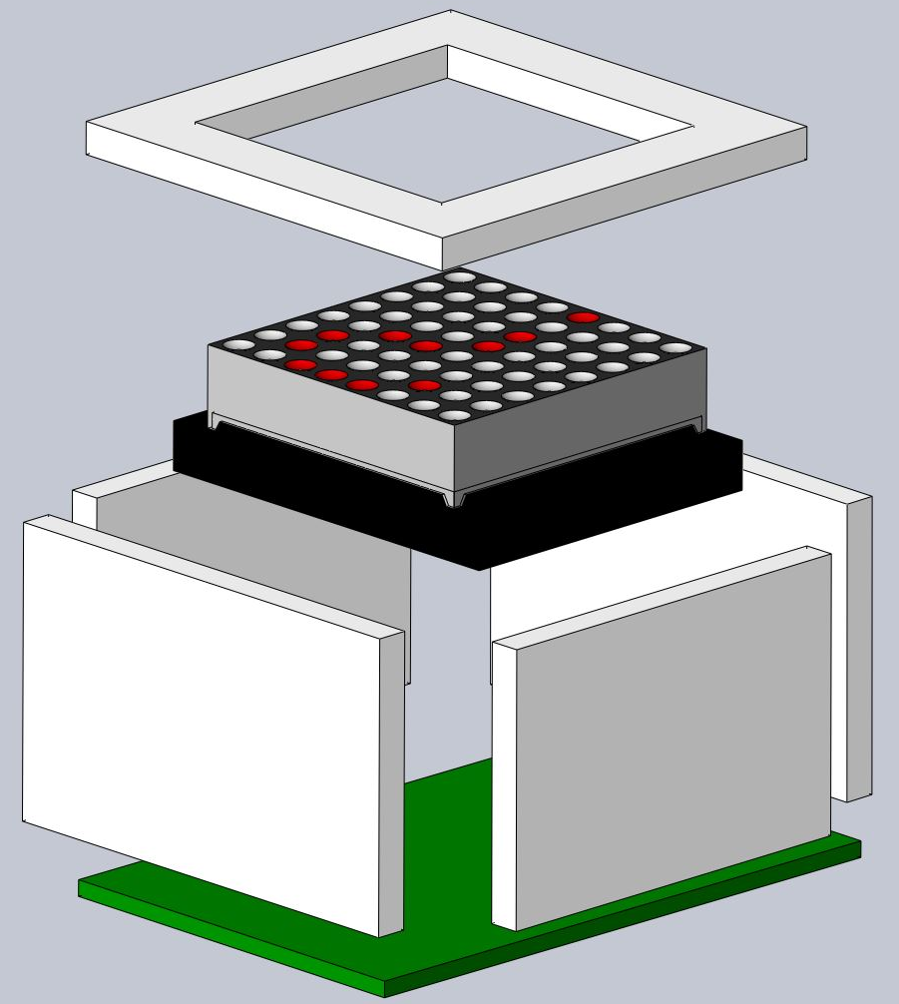
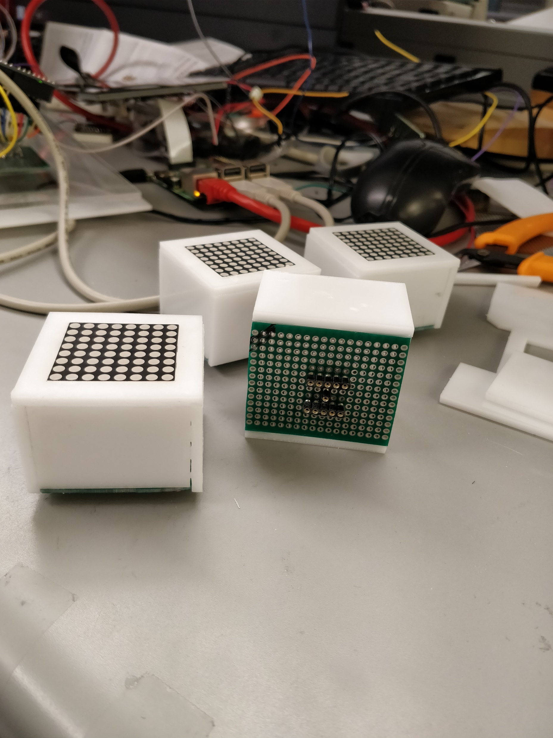
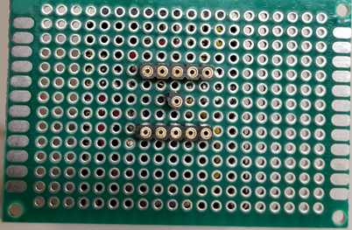
Laser cut acrylic pieces
Solder socket pins to protoboard
Wire LED matrix to socket pins
Cut protoboard to size
Put LED matrix in acrylic enclosure and glue together
Sand down the edge of the cube that is closest to the SCL pin to distinguish the orientation that the neuron block should be attached to the base (optional)

Slide 3
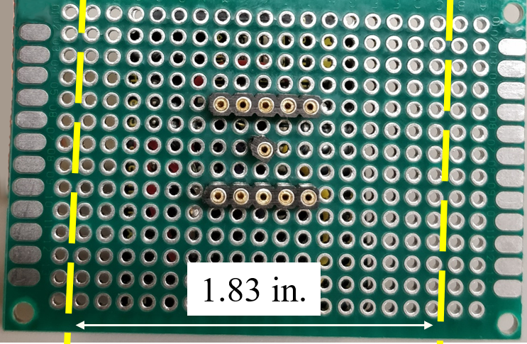
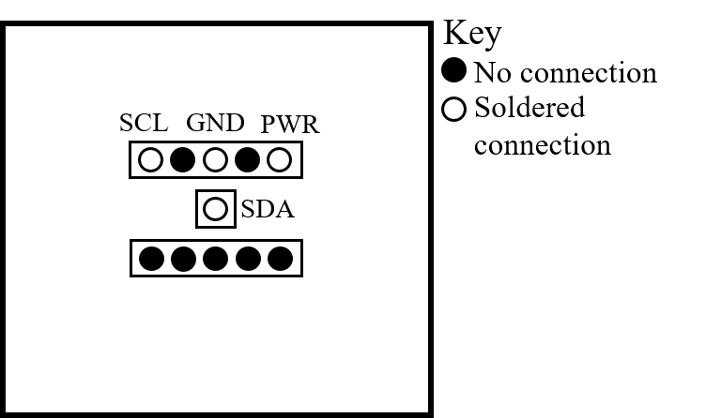
A
B
C
D
E
1. Laser cut the acrylic components with patterns provided in Appendix B.
2. Cut protoboard to size and solder socket pins to protoboard in configuration shown in Fig. 2A.
3. Wire LED matrix to socket pins and protoboard according to Fig. 2B. The completed step is show in Fig. 2C.
4. Apply adhesive and press together the acrylic components, protoboard, and LED matrix to complete the assembly of the neuron block. An exploded view is provided in Fig. 2D (wires not shown) [15]. Fig. 2E shows the completed neuron blocks.

Slide 4
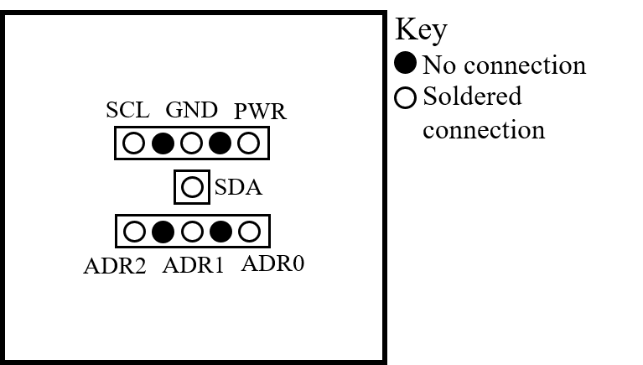
A
B
C
D
E

Slide 5
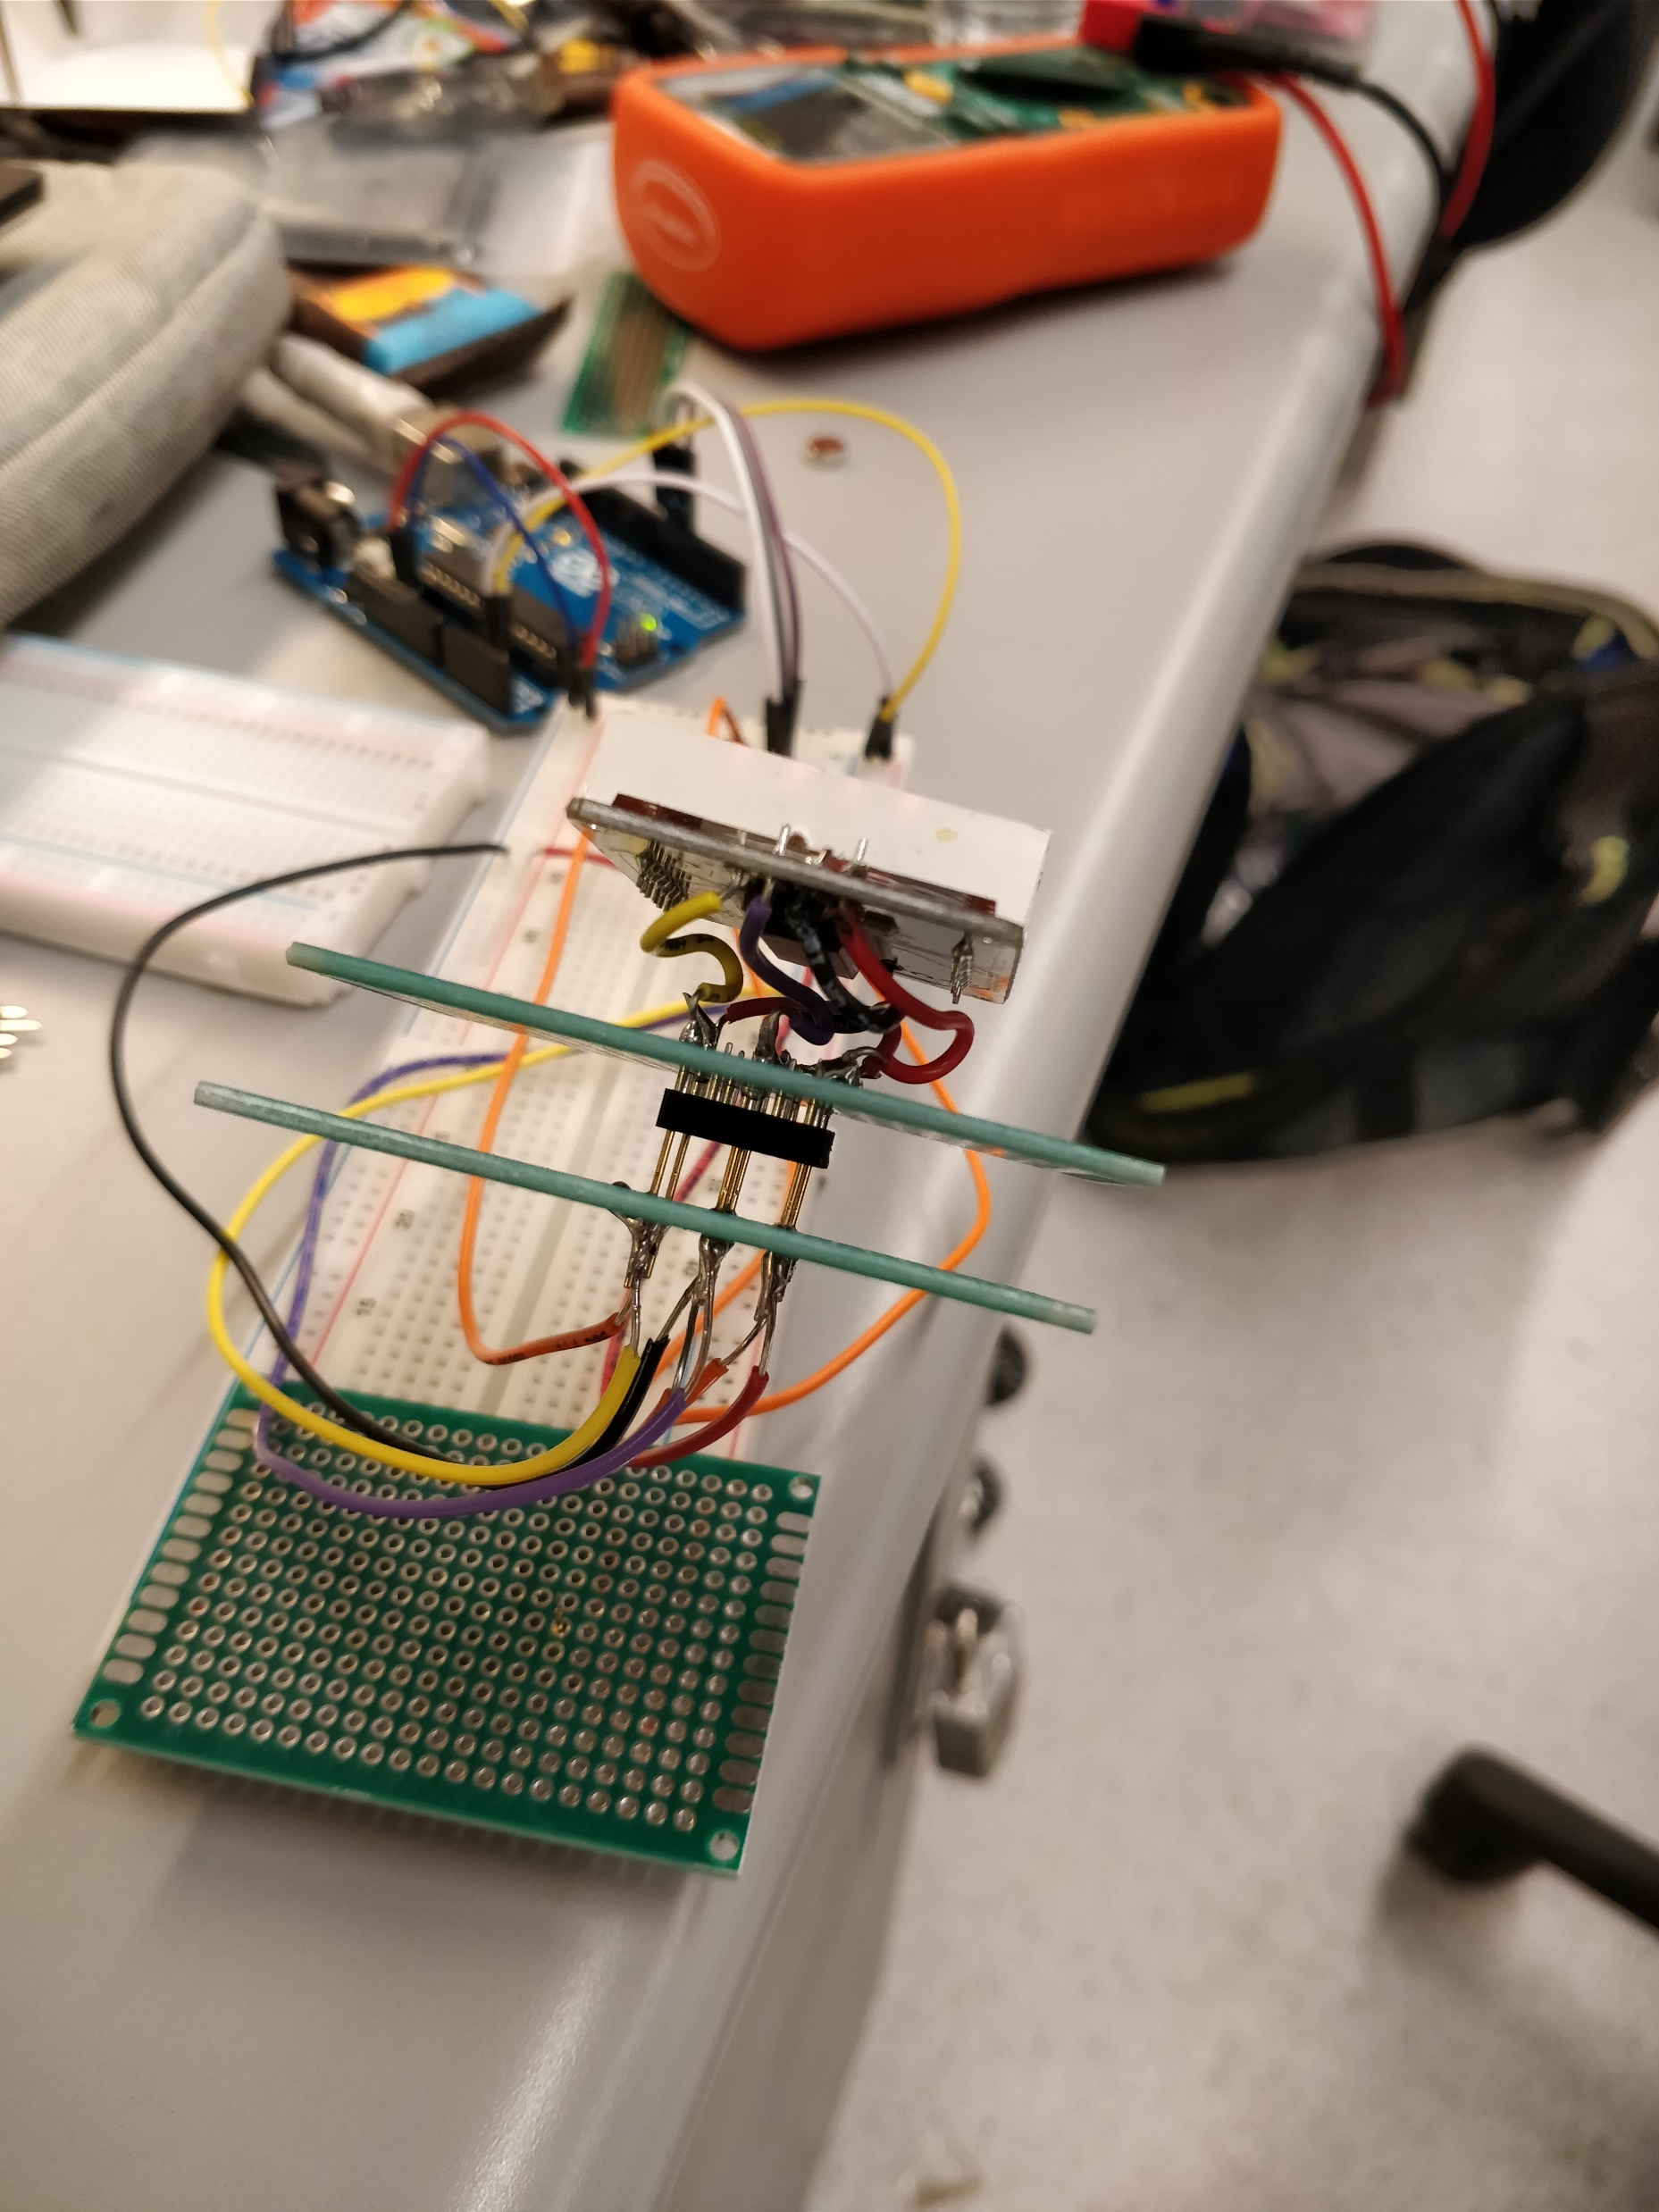
Laser cut acrylic components with patterns provided in Appendix B.
Solder pogo pins to protoboard as shown in Fig. 3A after confirming the locations of the pogo pins allow the neuron blocks’ socket pins to be inserted.
Solder a wire to one end of each pogo pin and the wire connect to the appropriate pin of the microcontroller. The completed step is shown in Fig. 3B. Fig. 3C shows how the LED matrix display and the socket pins of the neuron block fit onto the pogo pins.
Wire the microcontroller and Raspberry Pi according to Fig. 3D and Fig. 3E.
Assemble the base by applying adhesive to the acrylic components and the protoboards. Place the Raspberry Pi and microcontroller inside the base before completing the assembly. An exploded view of the assembly can be found in Fig. 3F (wires not shown).
(Optional) Adhere the LED strip to the perimeter of the base. Fig. 3G shows the completed base after this step.

Slide 6
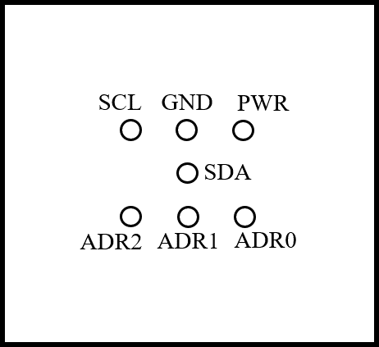
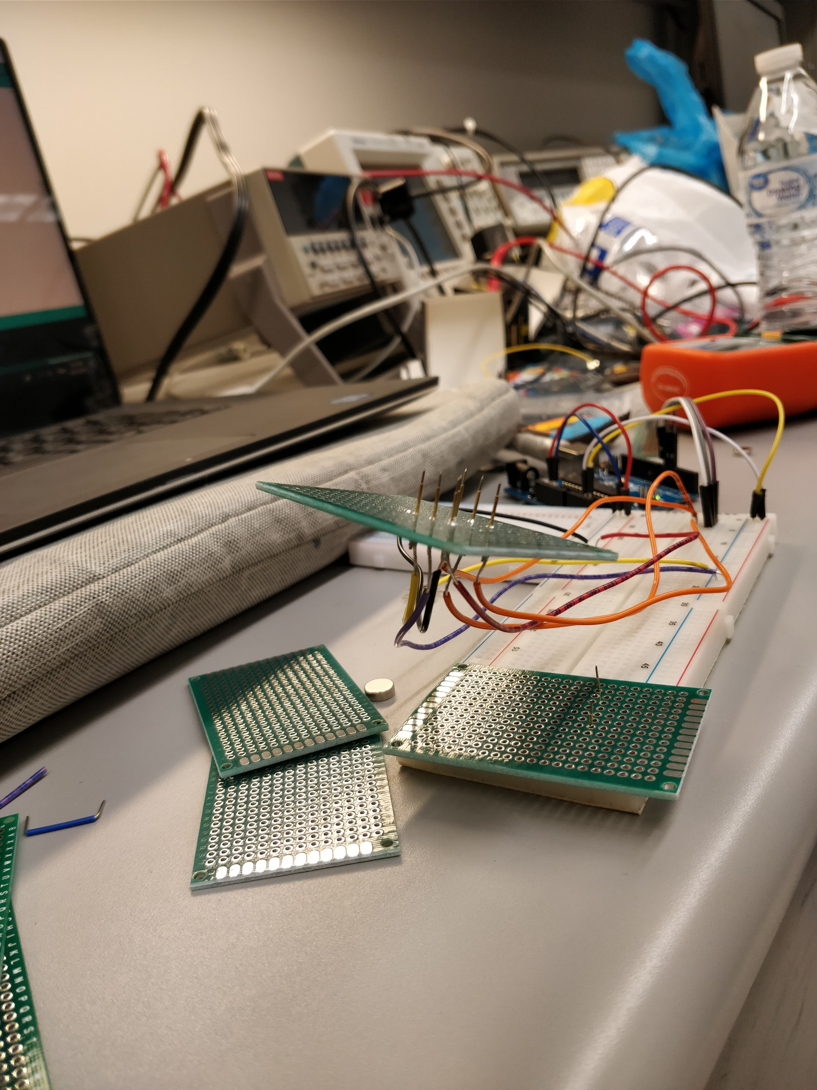
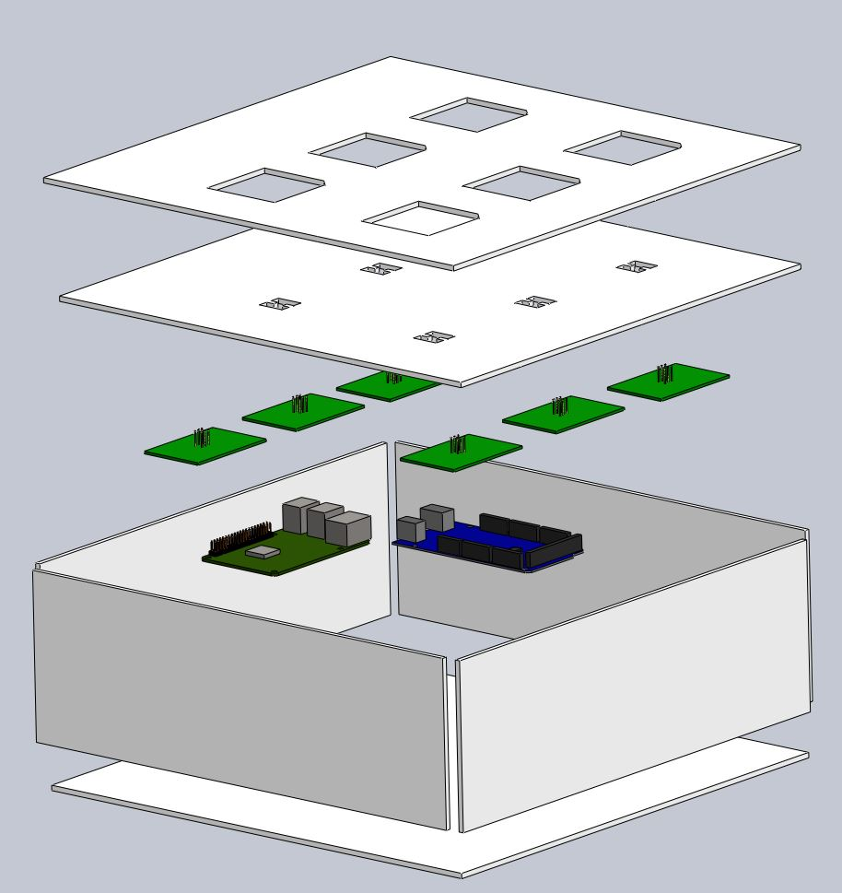
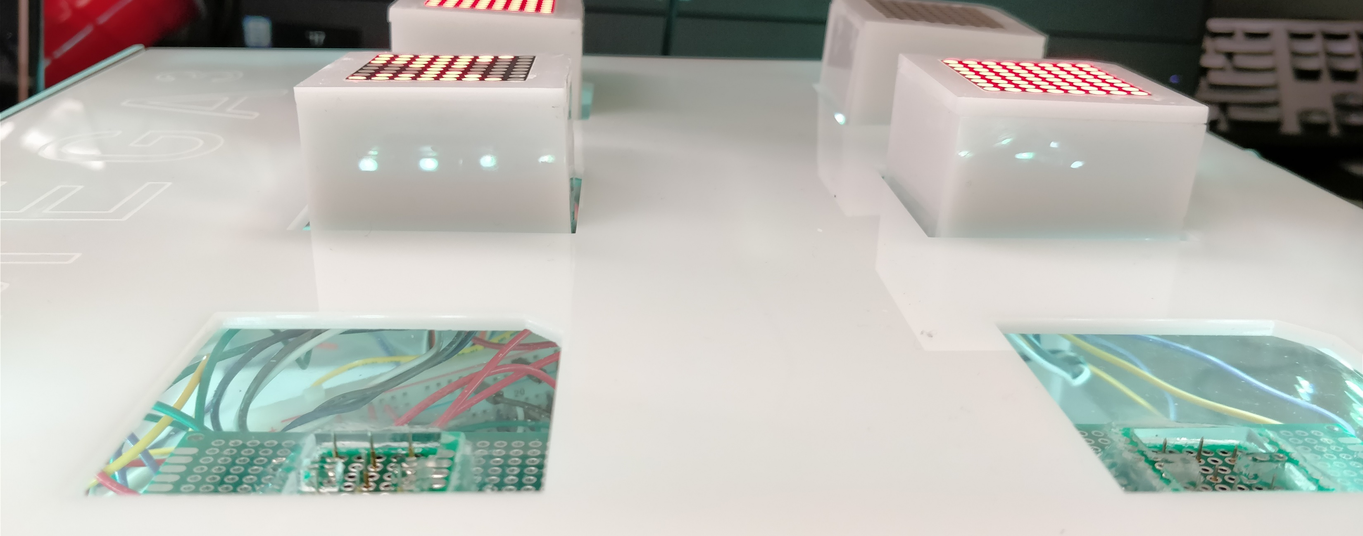
A
B
C
F
G
H
1. Laser cut acrylic components with patterns provided in Appendix B.
2. Solder pogo pins to protoboard as shown in Fig. 3A after confirming the locations of the pogo pins allow the neuron blocks’ socket pins to be inserted.
3. Solder a wire to one end of each pogo pin and connect the wire to the appropriate pin of the microcontroller. The completed step is shown in Fig. 3B. Fig. 3C shows how the LED matrix display and the socket pins of the neuron block fit onto the pogo pins.
4. Wire the microcontroller and Raspberry Pi according to Fig. 3D and Fig. 3E.
5. Assemble the base by applying adhesive to the acrylic components and the protoboards. Acrylic supports may be placed between the layers for additional stability if desired. Place the Raspberry Pi and microcontroller inside the base before completing the assembly. An exploded view of the assembly can be found in Fig. 3F (wires not shown) [16, 17].
6. Connect the HDMI display to the Raspberry Pi.
7. Adhere the LED strip to the perimeter of the base. (Optional) Fig. 3G and Fig. 3H shows the completed base after this step.

Slide 7
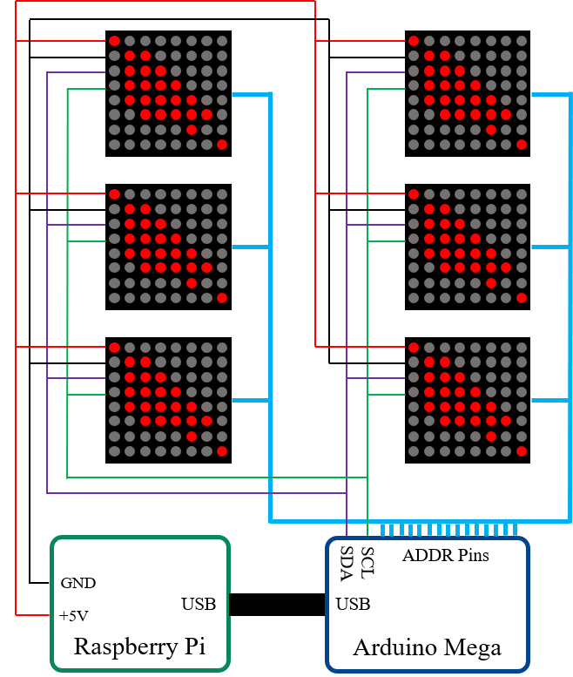
A
B
C
D
E
G
F

Slide 8
Key
No connection
SCL
GND
PWR
Soldered connection
SCL
GND
PWR
SDA
SDA
ADR1
ADR0
ADR2
ADR1
ADR0
ADR2

Slide 9

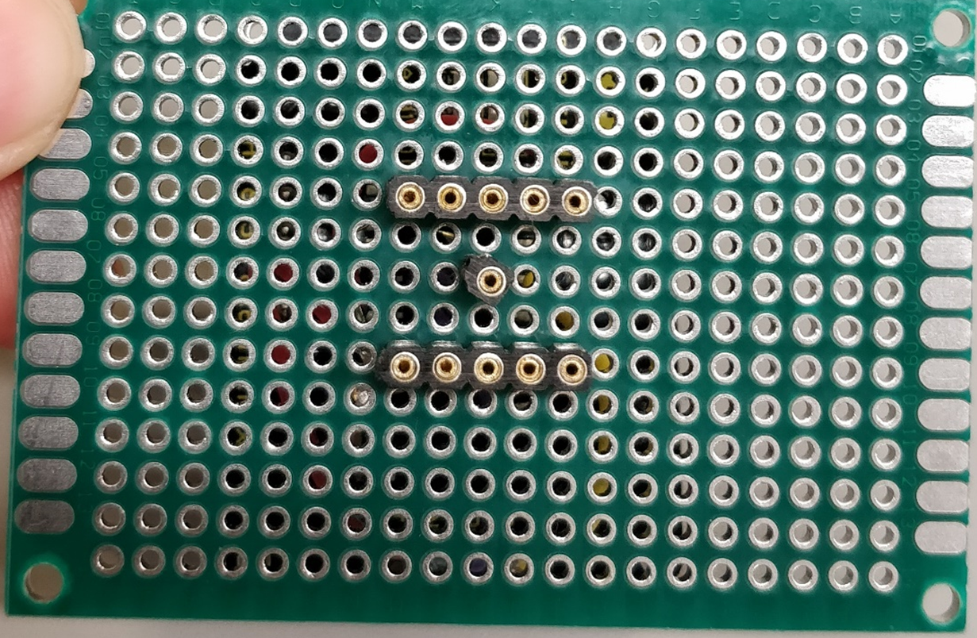
1.83 in.

